Slide 1


Online Payment Fraud Detection System

Slide 2

Group Members
Sandeep Kumar (2407350139005)
Abhishek Pal (2407350139001)

Slide 3
Introduction
Built a machine learning model to find fake online transactions.
Used a dataset with different features of transactions.
Used Random Forest to make predictions.
Handled unbalanced data with SMOTE (to balance normal and fraud cases).
Checked how well the model works using accuracy and confusion matrix.

Slide 4

Objectives
Accurately detect fake transactions
Reduce false positives
Improve the overall security of online payment systems.
Create a smart system that can identify which transaction is real and which one is fraud.

Slide 5

Importance of Fraud Detection in Online Transactions:
Helps businesses and customers avoid losing money.
Keeps online financial systems safe and trustworthy.
Spots fraud as it happens.
Makes overall security stronger for banks and financial institutions.

Slide 6
Methodology
We used online payment data.
We cleaned the data and fixed missing values.
We used Random Forest, XGBoost, and Logistic Regression.
We split data into training and testing sets to check the models.

Slide 7
Data Source
Dataset is collected from Kaggle website. Which is publically available. By using this website, you can access many more dataset for any kind of project.
https://www.kaggle.com/

Slide 8
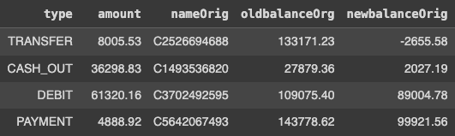
Key Features:
type: Type of transaction (e.g., PAYMENT, TRANSFER).
amount: The amount of money involved in the transaction.
oldbalanceOrg: Balance before the transaction.
newbalanceOrig: Balance after the transaction.
isFraud: Target variable indicating whether the transaction is fraudulent (1 for fraud, 0 for non-fraud).

Slide 9
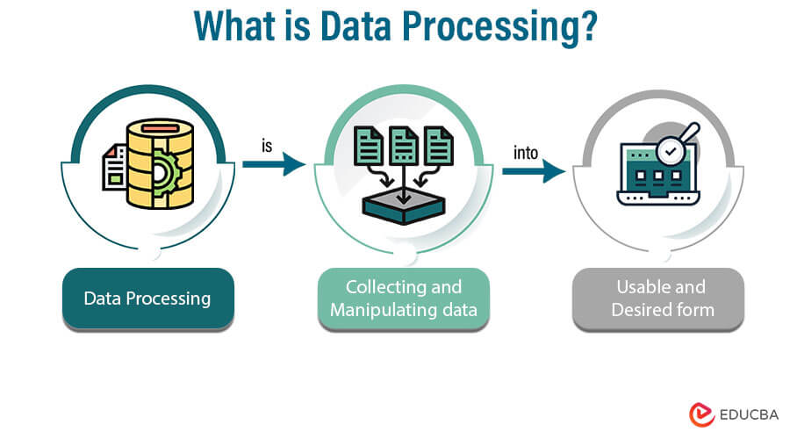
Data Processing
Handling Missing Data
Removed rows with missing values to ensure data quality.
Feature Selection
Selected key features (type, amount, oldbalanceOrg, newbalanceOrig) relevant for fraud detection.
One-Hot Encoding
Converted categorical variable type into numerical format using one-hot encoding.

Slide 10
data.dropna(inplace=True) data.isnull().sum()
x = data[['type', 'amount', 'oldbalanceOrg', 'newbalanceOrig']] y = data['isFraud']
CODE
Handling Missing Data
Feature Selection

Slide 11
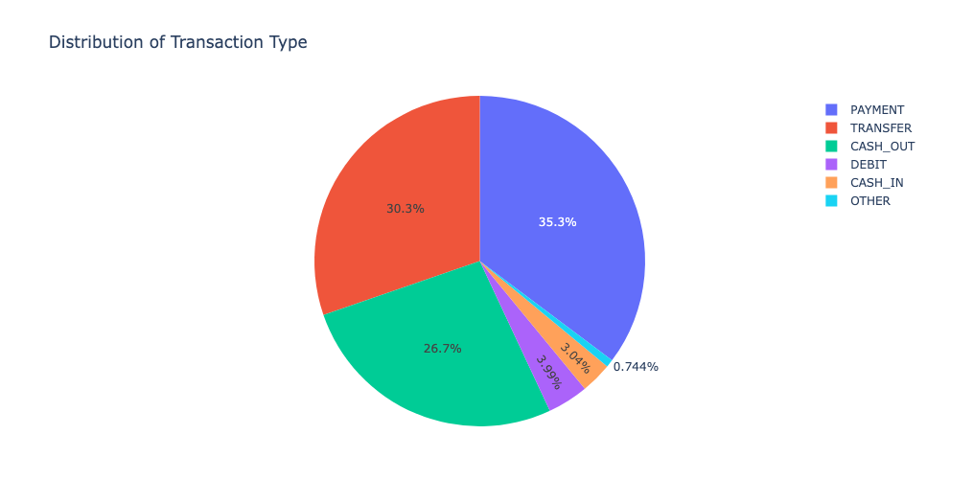
Dataset Statistics
The Dataset has the given types
TRANSFER
CASH_OUT
DEBIT
CASH_IN
PAYMENT
OTHERS
Distribution of Transaction Type

Slide 12
type=data['type'].value_counts() transactions=type.index quantity=type.values figure=px.pie(data, values=quantity, names=transactions, title='Distribution of Transaction Type') figure.show()
CODE:

Slide 13
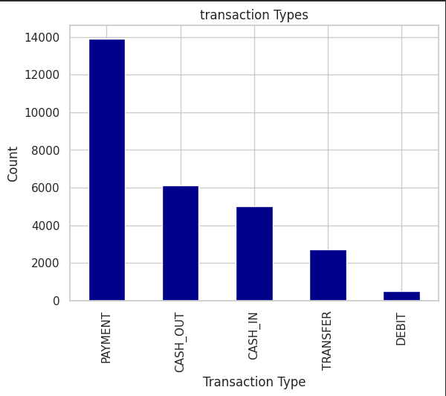
Barplot:
sns.barplot(x='type', y='amount', data=data)

Slide 14
Implementation
Collected transaction data and extracted key features.
Used Python and scikit-learn for model development.
Trained model can detect fraudulent transactions in real-time.

Slide 15
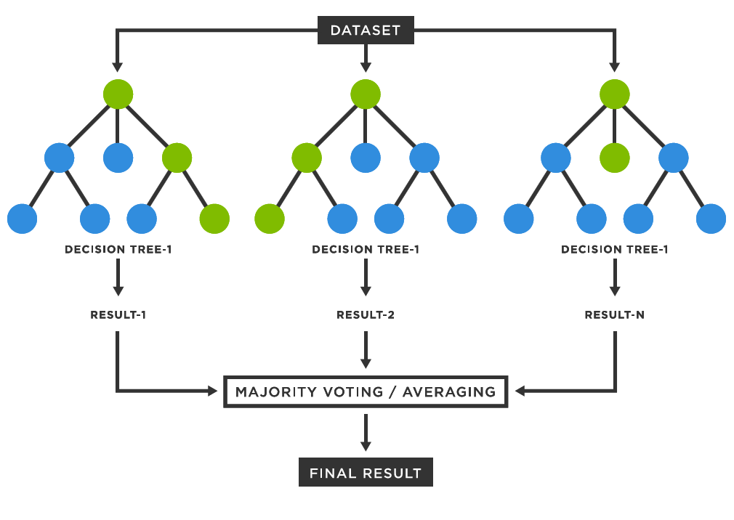
Modeling Approach:
Algorithm Selection:
We use Random Forest because it works well with big data.
It combines many decision trees to make better predictions.
It avoids mistakes by averaging results from all trees.

Slide 16
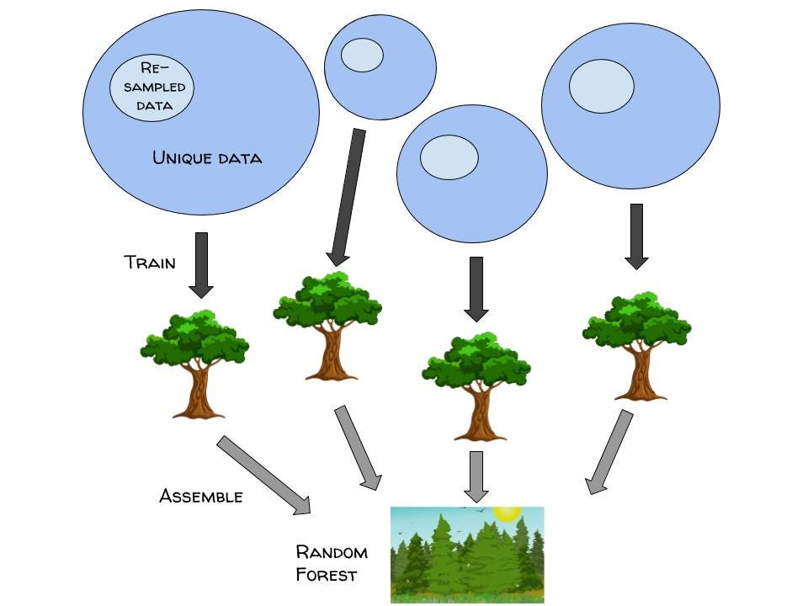
Model Training Process
SMOTE Technique: Used SMOTE on the training set to address class imbalance before training.
Model Fitting: Trained the Random Forest model on the resampled training data.
Data Split: Divided data into training (80%) and testing (20%) sets to evaluate performance.

Slide 17
CODE:
x_train, x_test, y_train, y_test = train_test_split(x, y, test_size=0.2, random_state=42)
from imblearn.over_sampling import SMOTE
model = RandomForestClassifier()
# Apply SMOTE to balance the classes
smote = SMOTE(random_state=42)
x_train_resampled, y_train_resampled = smote.fit_resample(x_train, y_train)
# Train the model on the resampled data
model.fit(x_train_resampled, y_train_resampled)

Slide 18
Model Evaluation:
Accuracy: Present the accuracy of your model on the test set (86.91%).
Confusion Matrix: Show a visual of the confusion matrix to illustrate true positives, true negatives, false positives, and false negatives.
Classification Report: Mention other key metrics like precision, recall, and F1-score, and explain what they mean.

Slide 19

FORMULAS:
Precision $=\frac{\text{True} \text{Positives}\text{ (}\text{TP}\text{)}}{\text{True} \text{Positives}\text{ (}\text{TP}\text{)+}\text{False} \text{Positives}\text{ (}\text{FP}\text{)}}$
$$\text{Recall} =\frac{\text{True} \text{Positives}\text{ (}\text{TP}\text{)}}{\text{True} \text{Positives}\text{ (}\text{TP}\text{)+}\text{False} \text{Negative}\text{(}\text{FN}\text{)}}$$
F1 = 2 x $\frac{\text{Precision}\text{×}\text{Recall}}{\text{Precision}\text{+}\text{Recall}}$

Slide 20
CODE:
y_pred = model.predict(x_test)
# Evaluate the model
accuracy = accuracy_score(y_test, y_pred)
print(f'Accuracy: {accuracy * 100:.2f}%')
from sklearn.metrics import classification_report, confusion_matrix
# Make predictions on the test set
y_pred = model.predict(x_test)
# Print detailed classification report
print(classification_report(y_test, y_pred))

Slide 21
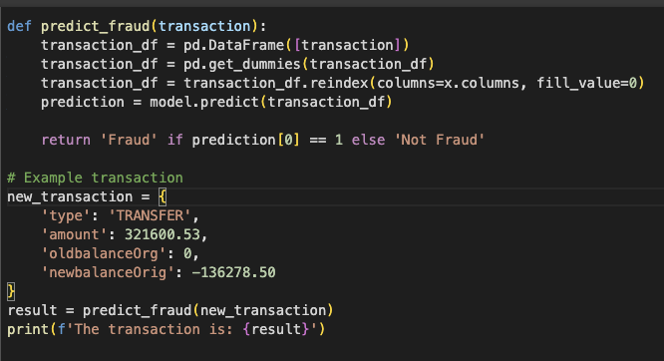
Fraud Prediction Example
Include a snippet of the predict fraud function, which takes a new transaction and predicts whether it’s fraudulent.
Show an example of how the function works with a sample transaction and display the prediction result.

Slide 22
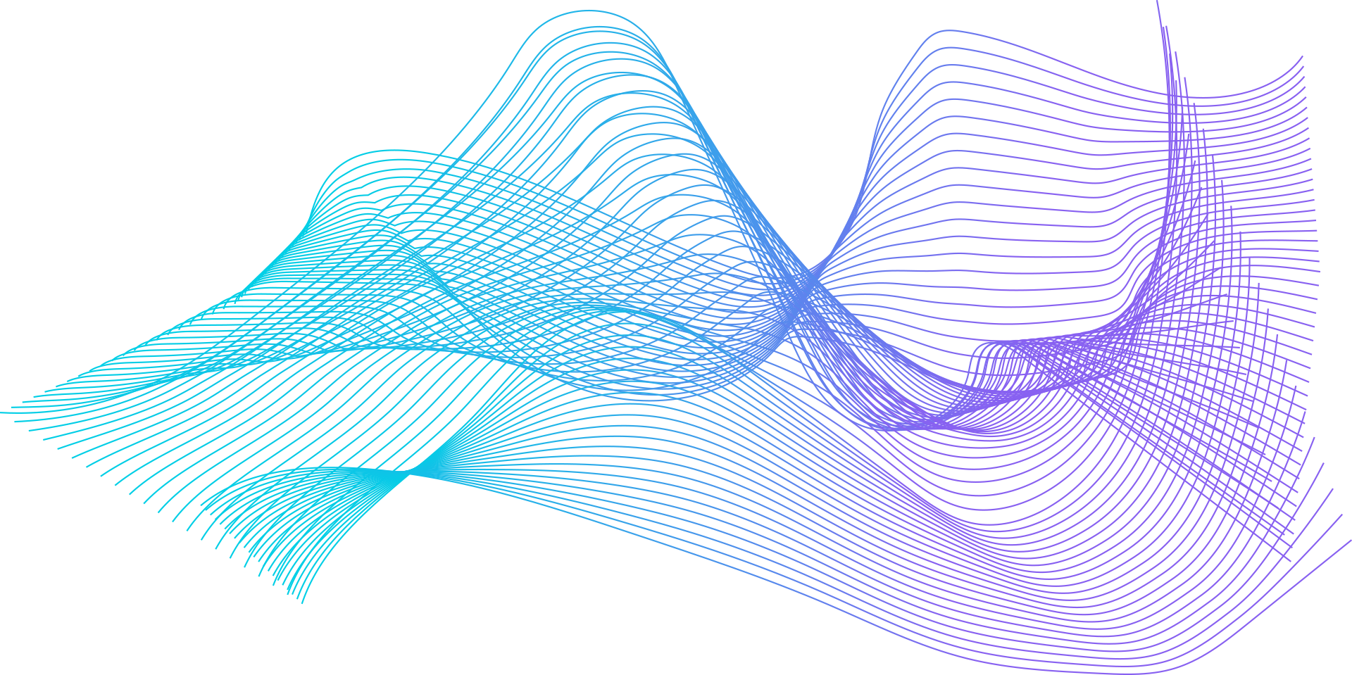


Conclusion:
Built a Random Forest model to detect online fraud successfully.
Used tools like confusion matrix and feature importance to check how well the model works.
Future improvements: try better models and add more features to detect fraud more accurately.

Slide 23
Thanks!

